Slide 1
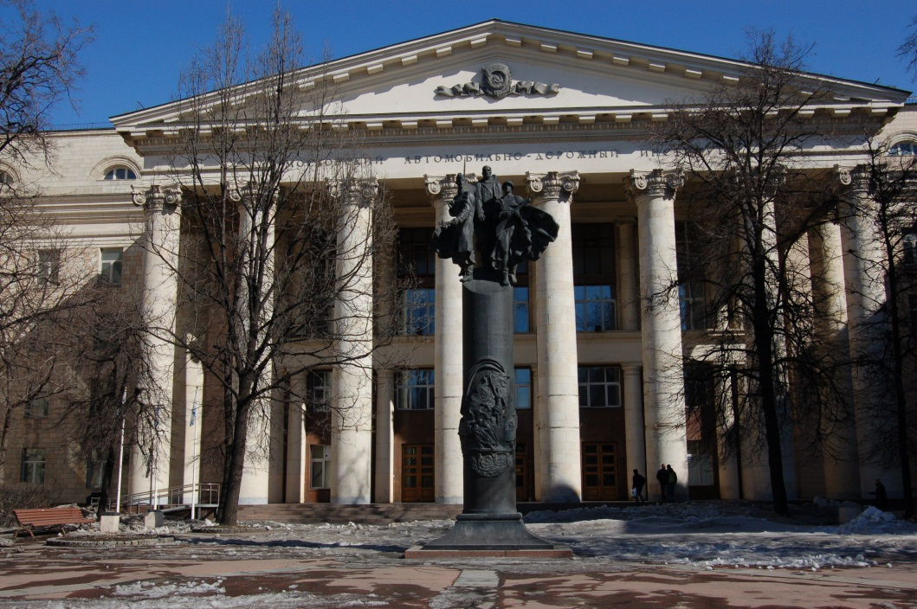
Moscow State Automobile & Road Technical University
Vasilyev Yury Emmanuilovich Ph.D., associate professor, Executive Director of MADI innovative infrastructure development program
vas@madi-dt.ru
Evgenyeva Anna Glebovna, Ph.D. student
Technopark MADI in the process of an innovation sphere formation in Russian Automobile & Road complex
Prague 2012

Slide 2
Federal law №127-FZ, dated 02.08.2009
«MADI»
SIE «MADI – Road Technologies»
SIE "Monitoring of highways and road technologies"
SIE "MADI – Integrated Intelligent Transport Systems"
SIE "Technopark MADI"
SIE "Ultrateh"

Slide 3
Modified bitumen
Polymers
Crumb rubber
«BITREK»
«UNIREM»
Sulphur
Construction bitumen

Slide 4
Asphalt concrete
high-density
dense
pure bitumen binder
with modifier «UNIREM»
SMA
mastic
polymer-modified binder
rubber-bitumen binder «BITREK»
sulfur-bitumen binder

Slide 5
BND 60/90
BITREK
PMB 60
SBB

Slide 6
wear-resistance
rutting resistance
cracking resistance
noisiness
thermal resistance
…

Slide 7
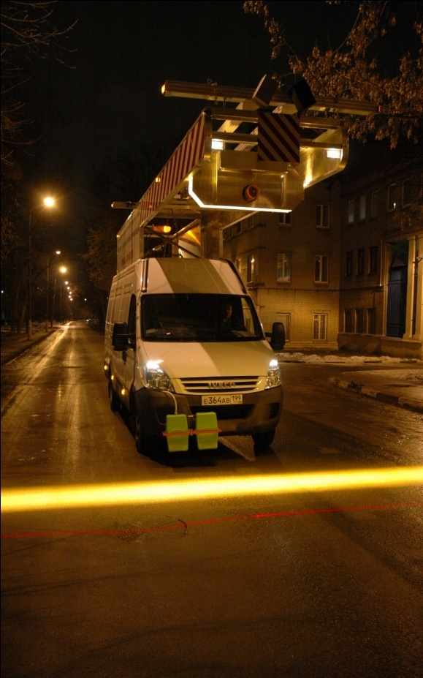
MAIN CHARACTERISTICS OF «ADS-MADI»
Low frequency georadar
High frequency georadar
Scanning of surface
Longitudinal evenness
Продольная ровность
1,5 м
Transverse evenness
12 м

Slide 8
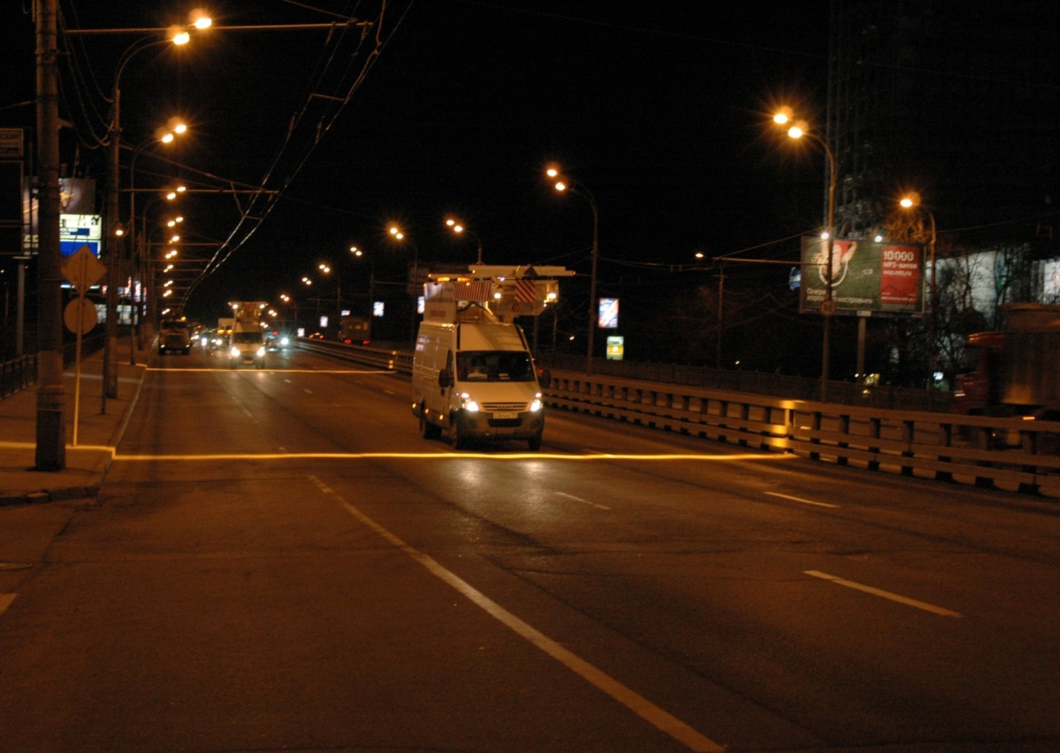
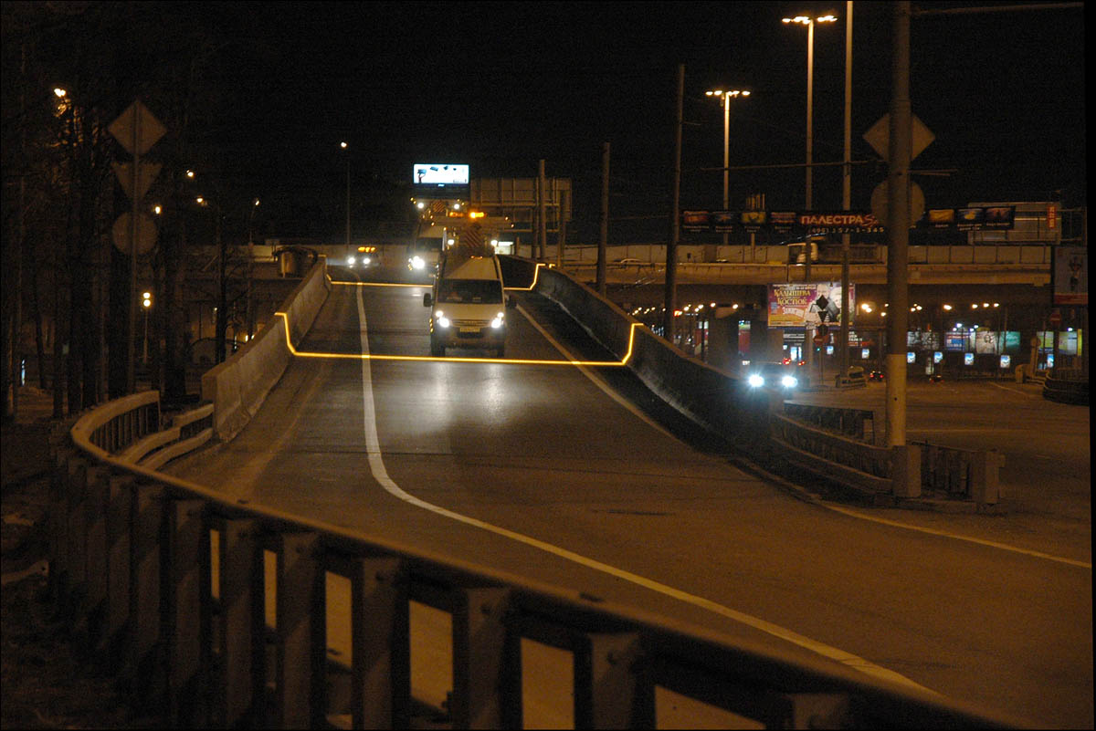

Slide 9
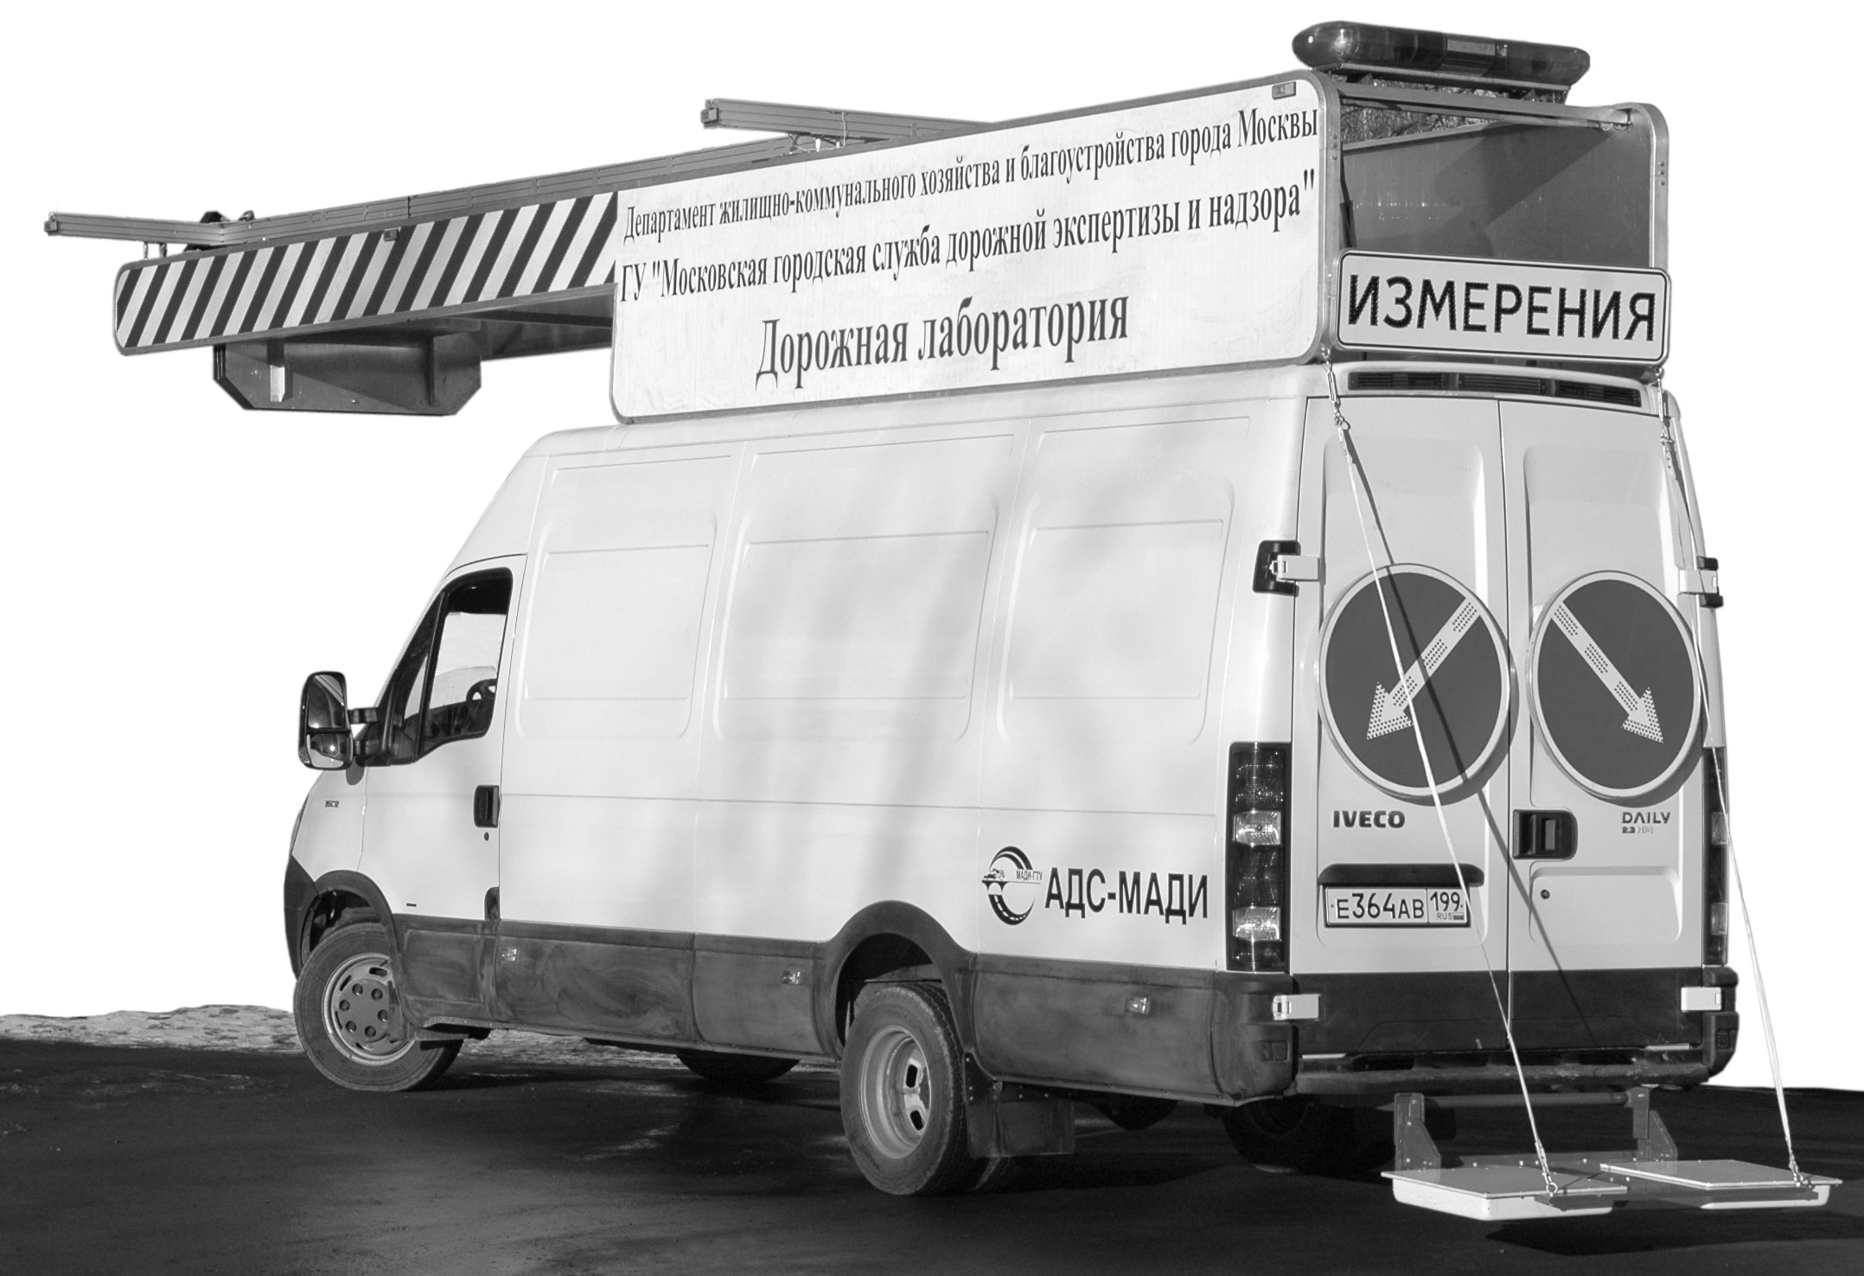
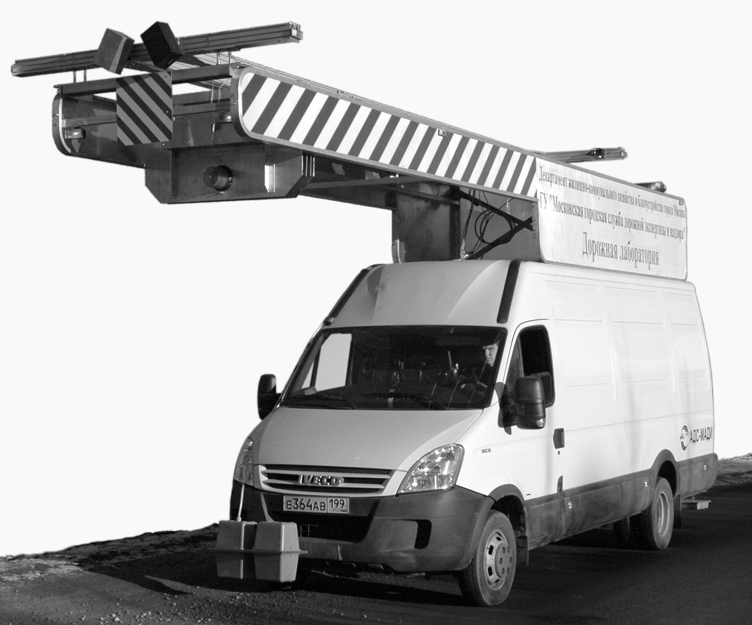
LAYOUT OF EQUIPMENT ON THE MOBILE LABORATORY «ADS-MADI»
Low frequency georadar,
diapason 7 – 10 m
Line camera of side looking
Line camera of the road surface
Camera of the volumetric scanner
Laser generator of the volumetric scanner line
Laser sensor of the longitudinal evenness measurement system
Acceleration sensor of the longitudinal evenness measurement system
Lamp of the line camera of the road surface
BASIC SYSTEMS
Longitudinal evenness fixation system - 1d
Object detection fixation system (defects, horizontal road marking, etc.) – 2d
Transverse evenness gaging system – 3d
Georadar sounding system – 4d
Position control system
High frequency georadar, diapason up to
100 cm

Slide 10
MOSCOW RING ROAD
5th lane
4th lane
3^{d}
lane
2^{d}
lane
1st lane
Value, mm
Value, mm
Value, mm

Slide 11
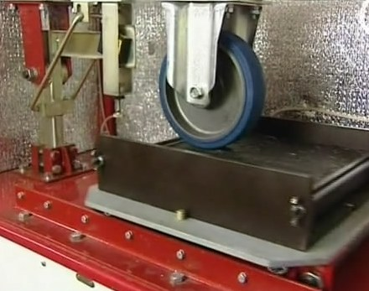
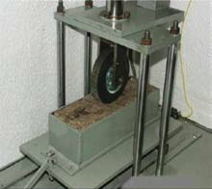
LABORATORY RUTTING TESTS
b)
c)

Slide 12
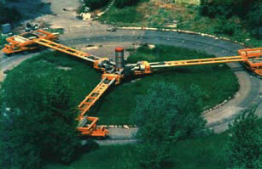
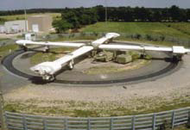
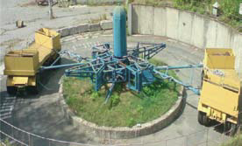
Slovak Republic
France
Ukrain

Slide 13
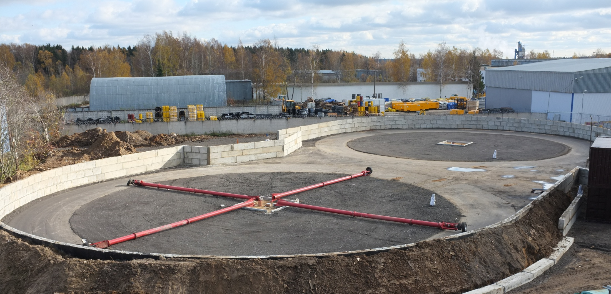
UNIVERSAL TEST FACILITIES COMPLEX
PAVEMENT AND TYRES TESTING
Phase I (light stand)
– December 2011
Phase II (heavy stand)
– November 2012

Slide 14
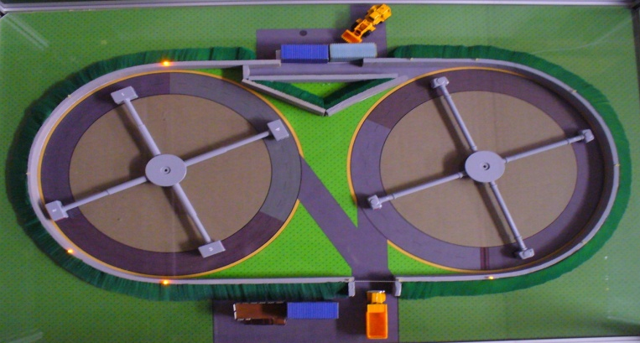
Parameters | Stand
 | «light» | «heavy»
Diameter, m | 30 ± 2 | 30 ± 2
Speed, km per hour | up to140 | up to 80
Mass, kg | up to 600 | up to 7 000
Lane width, m | 3,75 | 3,75

Slide 15
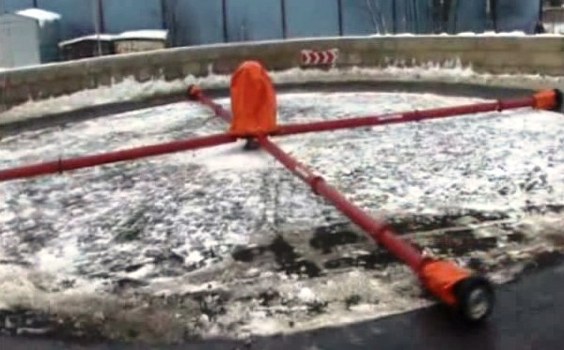
Stud influence
Traction and driven wheels
Comparison tests for 3 different material types (А, В, С)
Speed rate, up to 140 km per hour
Speed-up and slowdown
V = 140 km per hour

Slide 16
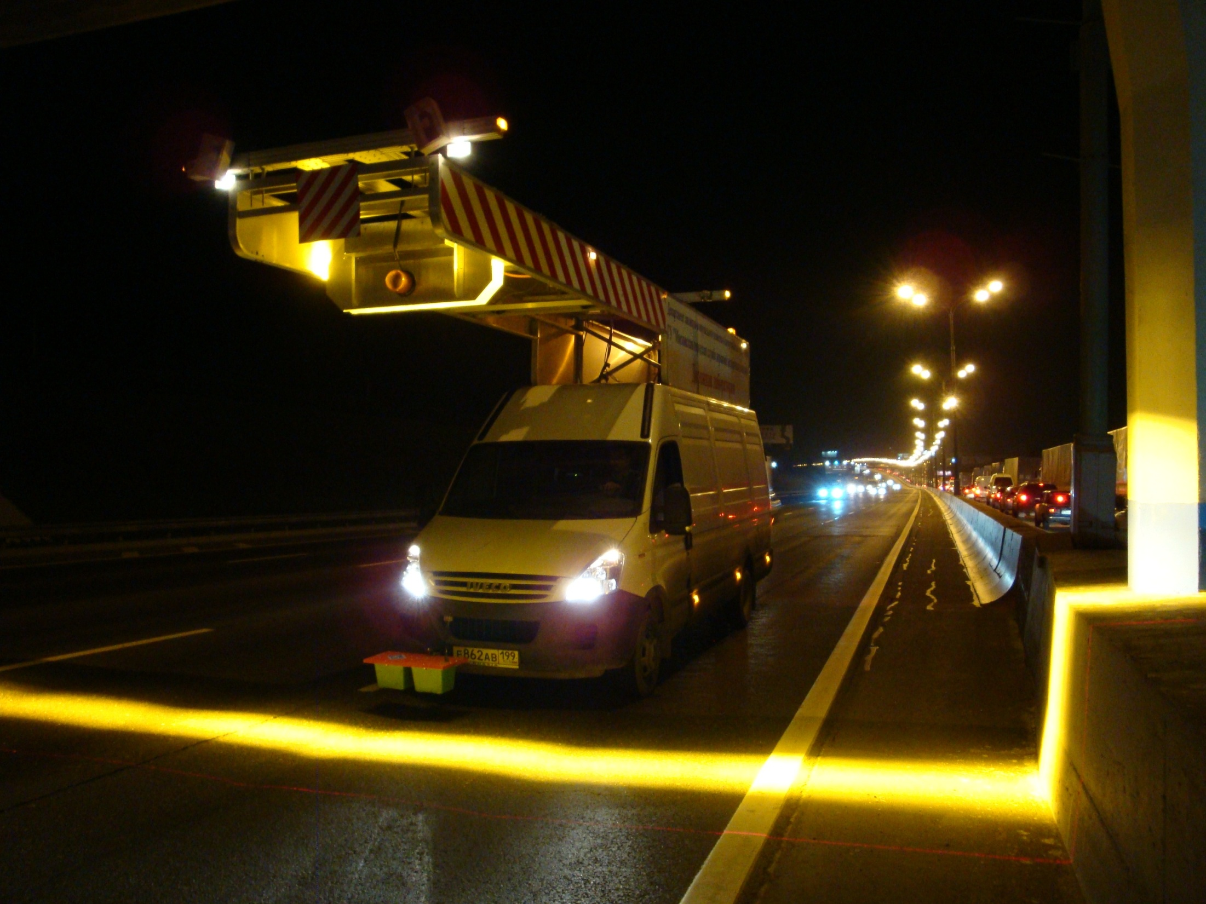
Thank you for your attention!
Any questions?
vas@madi-dt.ru

